Slide 1
RVAPT 6 Post Exploitation

Slide 2
Announcements https://bit.ly/330YbZZ

Slide 3
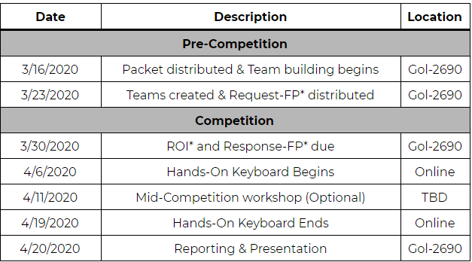

Slide 4
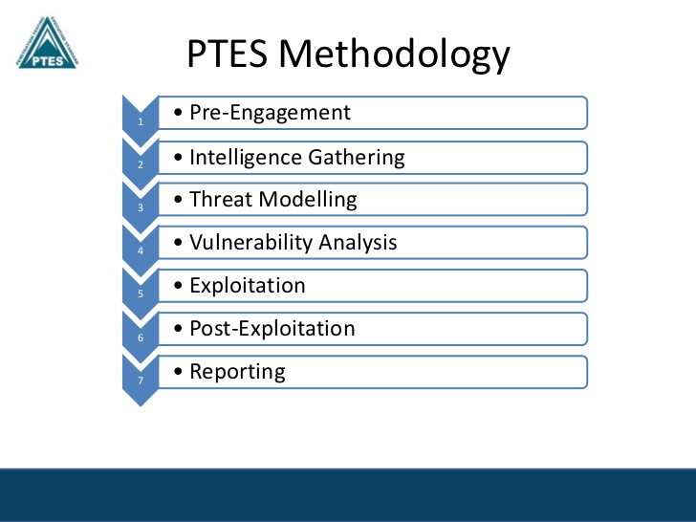
Agenda
Announcements
Attack Life Cycle Review
Post Exploitation
Privilege Escalation
Lateral Movement
Persistence

Slide 5
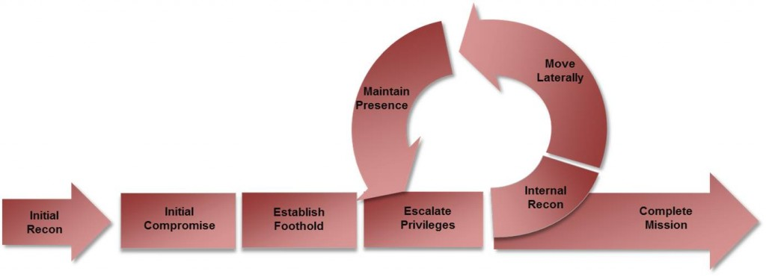
Attack Life Cycle Review
Privilege Escalation - Internal Recon - Move Laterally - Maintain persistence
Focus equally for Red Teaming & Penetration Testing

Slide 6
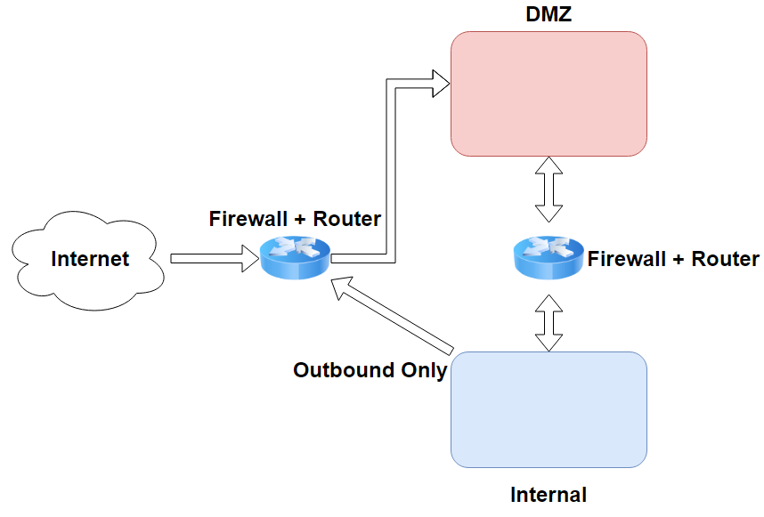

Slide 7
Post Exploitation
“The purpose of the Post-Exploitation phase is to determine the value of the machine compromised and to maintain control of the machine for later use.”
Sensitivity of the Data stored
Potential in further compromising the network
“Now what?”
Privilege Escalation
Lateral Movement
Persistence
(Data Exfiltration) *
Lots of information. Remember keywords, and research on your own!

Slide 8
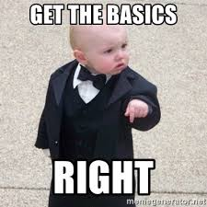
General things
Whoami?
Which machine am I on?
hostname, hostnamectl, lsb_release -a
Am I in virtualized environment?
running_in_docker() {awk -F/ '$2 == "docker"' /proc/self/cgroup | read}
What ports are opened? Firewalled?
netstat -tulpna, netstat -ano, http://portquiz.net
Where am I - Subnet, Domain
ip a, ipconfig /all, get-addomain
Watch out for multiple interfaces / dual homed
Who am I talking with?
arp -a

Slide 9
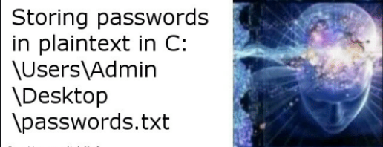
Privilege Escalation
Process of exploiting a vulnerability, misconfiguration, human error to gain elevated access/status within the system
Why? Access Control
Methods
System Enumeration
Finding Anomalies
Experience
Actually making the same mistake & laziness
A little talk about kernel exploitation

Slide 10
Privilege Escalation - Linux
Linenum.sh, linuxprivchecker.py, linpeas.sh
Closer look at interfaces
In DMZ - Usually linux boxes for running services
What processes are running, and what does this server do?
Beware of Virtualized environment
Outdated softwares & Local Privilege Escalation
Human Errors
Custom scripts, bash_history, ssh keys, incorrect file permission, logs, mails
Setuid, cronjobs, sudo rights, PATH misconfiguration, NFS share, services & processes, weak service configuration

Slide 11
Privilege Escalation - Windows
Windows PEASS (Priv.Esc Awesome Scripts Suite), PowerUp.ps1
Human Error
Thank you end users! Thank you lazy sysadmins!
Configuration files
Unattended.xml, sysprep.xml
Weak service configuration
Weak directory permissions + DLL Hijacking
Unquoted Service Path

Slide 12
Privilege Escalation - Domain
PowerView.ps1
Password Spraying
Relaying attacks - Responder
Human Errors - Account comment, plaintext files …
Find-LocalAdminAccess -Verbose // Check hosts which we have local admin
Invoke-UserHunter -CheckAccess // Check hosts with Domain Admin session
Credential dumping through Mimikatz
And a bunch more
Kerberoasting, Unconstrained Delegation, Constrained Delegation, Zero Logon

Slide 13
Lateral Movement
“Techniques that cyber attackers, or "threat actors", use to progressively move through a network”
Where am I ? - Enterprise networks can be enormous
Analyzing the Big Picture
Hostname
Domain name
Connected subnets
What’s my end game goal?

Slide 14
Lateral Movement - 2
Pretty straight forward after achieving Domain Admin
Powershell Remoting
Uses WinRM as the background, think of it as default SSH in Windows
Enter-PSSession -Computername <FQDN> -Credentials <domain\user>
PSExec
Requires SMB, open shares & read/write permission
Often need local administrator account credential (due to write permission in shares)
Pass the Hash
Obtain ntlm hash of Domain Admin
Open shares
WMI

Slide 15
Persistence
“Techniques that attackers use to keep access to systems across the network”
Mostly for Red team engagements, much less for penetration testing
Red Team
“Persistence Testing”
Based on “Assume Breach” Mindset
Evaluate client’s blue team
Penetration Testing
Mostly for “going back”
Document all artifacts created - (test users, backdoors, agents…)
Clean up all artifacts after during & after engagements
Mitre ATTACK Framework - Persistence

Slide 16
Persistence - Linux
TODO: Finish the slide

Slide 17
Persistence - Windows
TODO - Finish the slide

Slide 18
Resources
https://github.com/swisskyrepo/PayloadsAllTheThings/blob/master/Methodology%20and%20Resources/Active%20Directory%20Attack.md#open-shares
https://www.fuzzysecurity.com/tutorials/16.html

